Slide 1
Potential Practice Exercises for Module 2

Slide 2
Module 2 · Video 1 · Demand and Revenue
The Netflix 2014 Price Increase
In 2014, Netflix raised its monthly price by $1, from $7.99 to $8.99
Then: 50 million subscribers, own-price elasticity of demand ≈ −2
Implications of the price increase for:
Number of subscriptions (quantitative)?
Revenue (qualitative)?
Profits (speculative)?
Group Discussion
Management 405 · Module 2 · Demand Analysis
2

Slide 3

Module 2 · Video 1 · Demand and Revenue
Solution: Netflix
Subscriptions decline — by how much? Use Method 1 with E_{D} = −2 :
$$E_{D} = \frac{\%ΔQ}{\%ΔP} = \frac{\%ΔQ}{12.5\%} = −2$$
where %ΔP = (8.99 − 7.99) / 7.99 = +12.5%, so %ΔQ = −25%
→ a 25% decline in subscriptions
Revenue: demand is elastic, so quantity outweighs price → revenue falls
Profits: fewer subscribers, near-zero cost savings → profits likely fell too
Management 405 · Module 2 · Demand Analysis
3

Slide 4
Module 2 · Video 1 · Demand and Revenue
Mega Millions, Revisited
April 2025: Mega Millions raised its ticket price from $2 to $5 (+150%)
In New York, tickets sold per drawing fell from ~1.9 million to ~560,000 (≈ −70%)
We computed E_{D} ≈ −0.47 → inelastic
Inelastic demand suggests revenue should RISE when the price rises. Did it?
Caution: Method 1 approximates % changes – for LARGE changes like this one, the elasticity-revenue rule can mislead
Group Discussion
Management 405 · Module 2 · Demand Analysis
4
Notes:
Back to Mega Millions. Method 1 gave us an elasticity of about −0.47 — inelastic — which suggests the price increase should raise revenue. In fact, revenue per drawing FELL from roughly $3.8 million to $2.8 million. The catch: the price rose 150%, and Method 1 is a small-change approximation. With changes this large, the initial-point elasticity and the revenue rule based on it can point the wrong way — a good reason to be careful before applying the rule to big price moves.

Slide 5


Module 2 · Video 2 · Marginal Revenue
Inside Out 2's Marginal Revenue
Demand for streaming Inside Out 2 on Disney+ (Q: viewers, in millions):
$$Q = 20 − \frac{1}{2}P$$
What is the revenue-maximizing price?
Why might Disney care about revenue maximization?
Poll Break
Management 405 · Module 2 · Demand Analysis
5

Slide 6
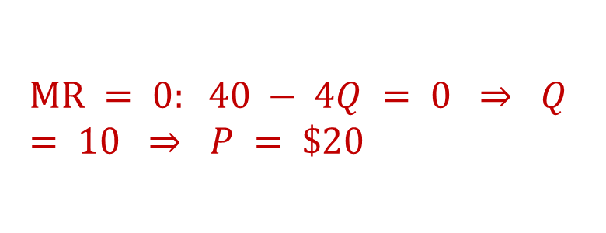
Module 2 · Video 2 · Marginal Revenue
Solution: Inside Out 2's Revenue-Maximizing Price
Revenue is maximized where MR = 0 . Compute MR using the 3-step method:
1. Inverse demand: P = 40 − 2Q
2. Total revenue: TR = 40Q − 2Q²
3. Derivative: MR = 40 − 4Q
$$MR = 0: 40 − 4Q = 0 ⇒ Q = 10 ⇒ P = \$20$$
Why revenue maximization? The marginal cost of one more stream is close to zero – so maximizing revenue is (almost) maximizing profit
Management 405 · Module 2 · Demand Analysis
6

